Slide 1
3D reconstruction

Slide 2
3D cone beam reconstruction vs 2D fan beam.

Slide 3
3D
reconstruction

Slide 4
Cut out 2D
segments

Slide 5
2D fan beam
reconstruction

Slide 6
?
2D fan-beam
off center
reconstruction

Slide 7
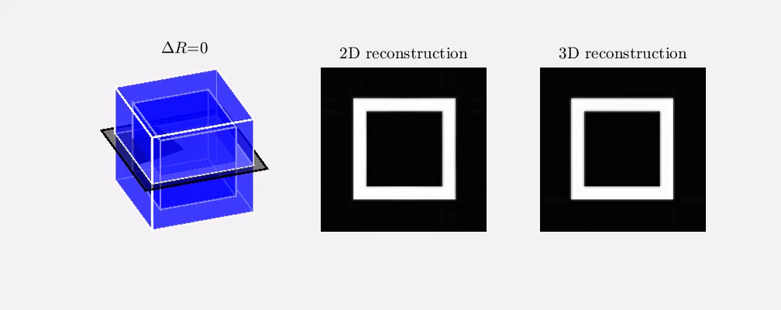
3D vs. 2D

Slide 8
Accuracy of 3D Reconstruction
An experiment with phantom data

Slide 9
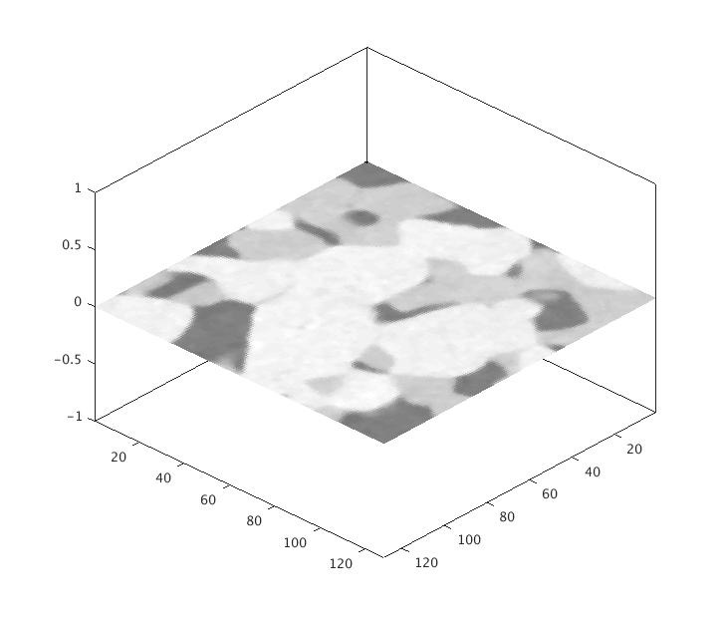
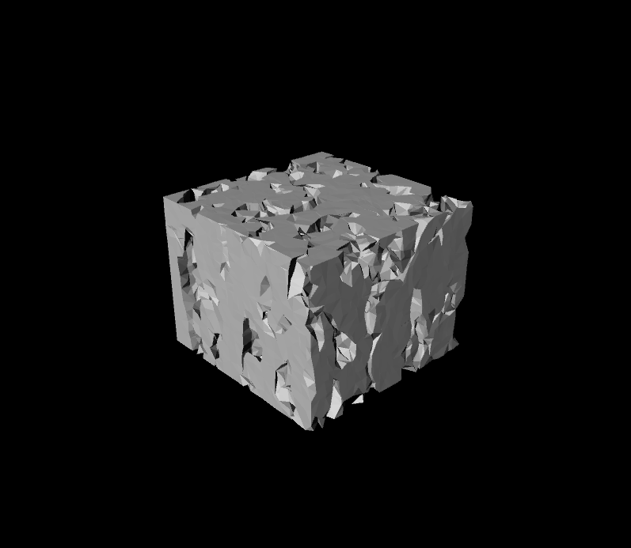
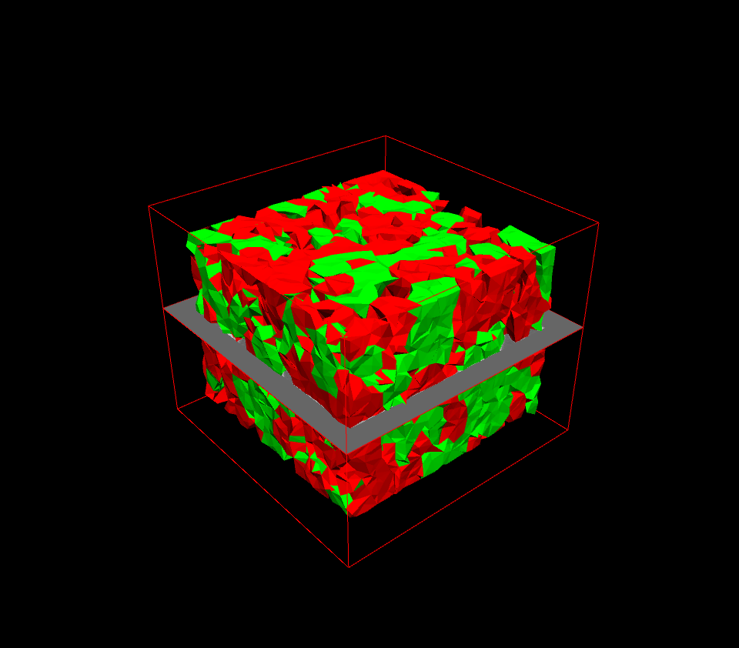
Accuracy
The phantom fuel cells
The phantom fuel cells consists of two types of material

Slide 10
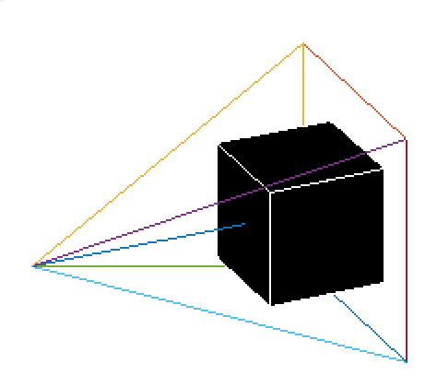
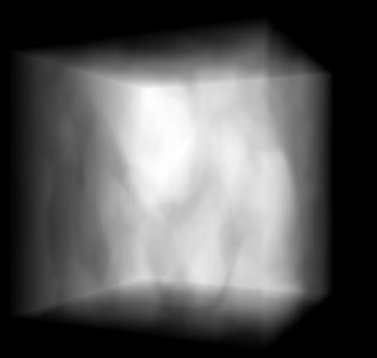
Accuracy
Cone beam setup
The object rotates by its center
Image observed by the detector

Slide 11
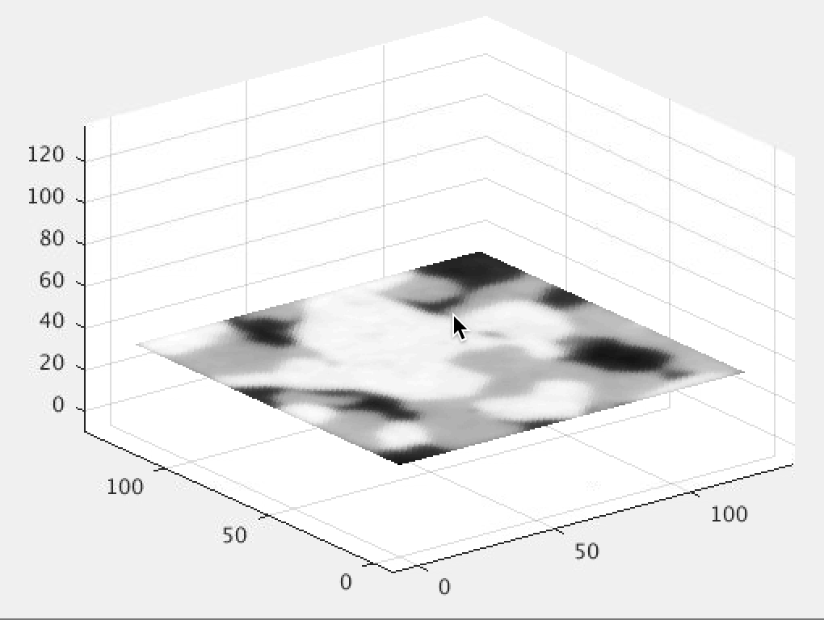
Accuracy
Reconstruction from phantom fuel cells

Slide 12
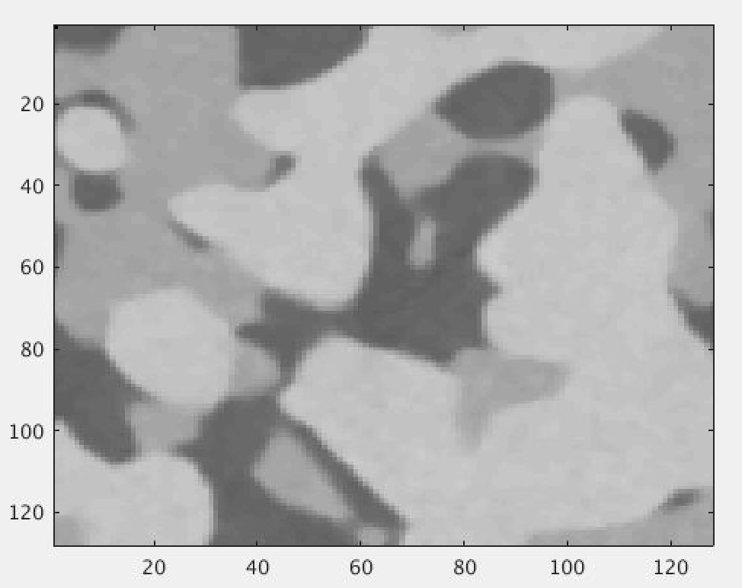
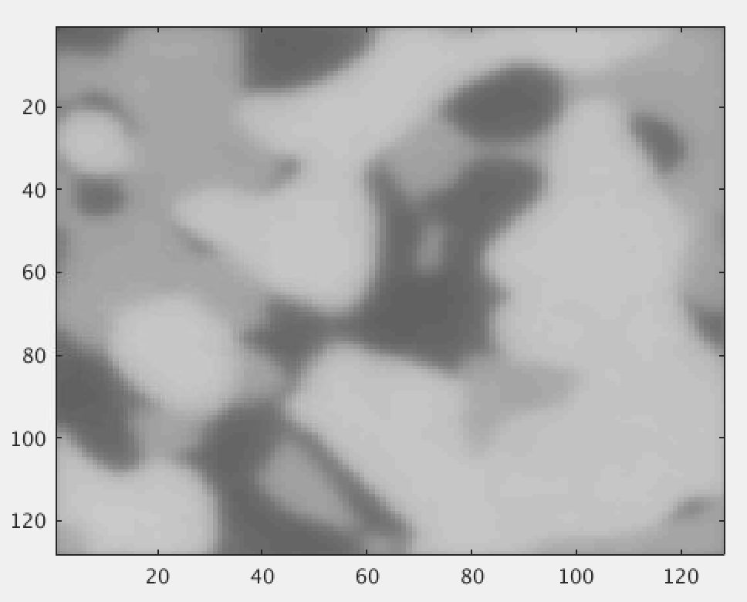
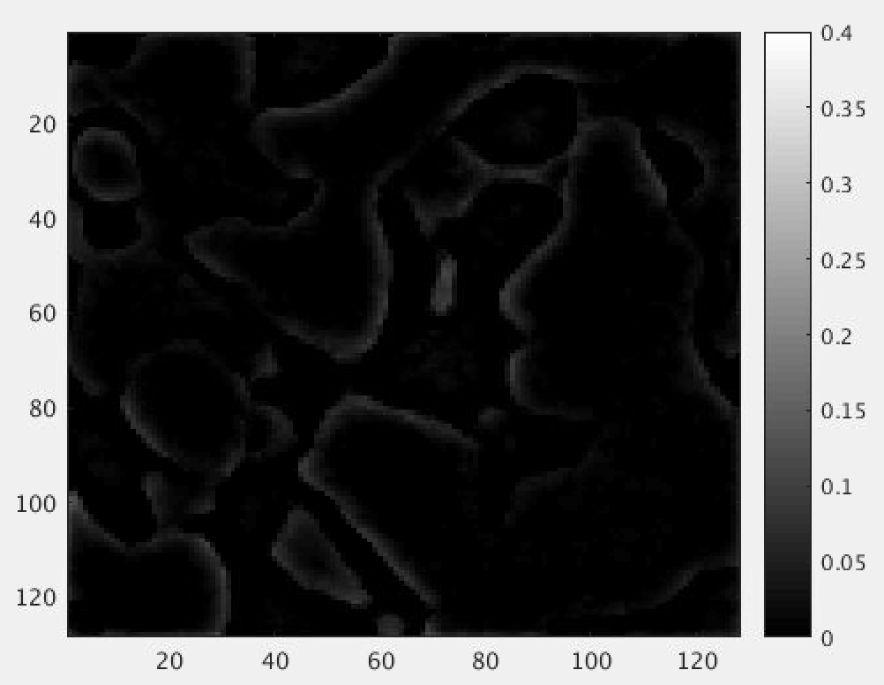
Accuracy
Difference
Phantom
reconstructed
difference

Slide 13
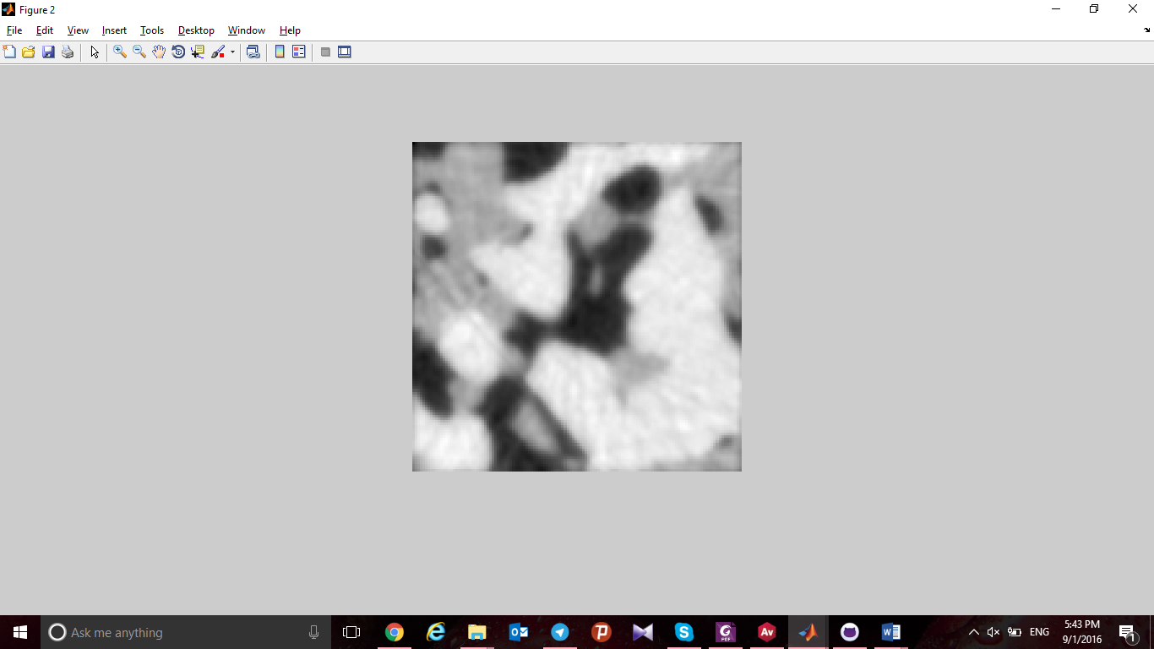
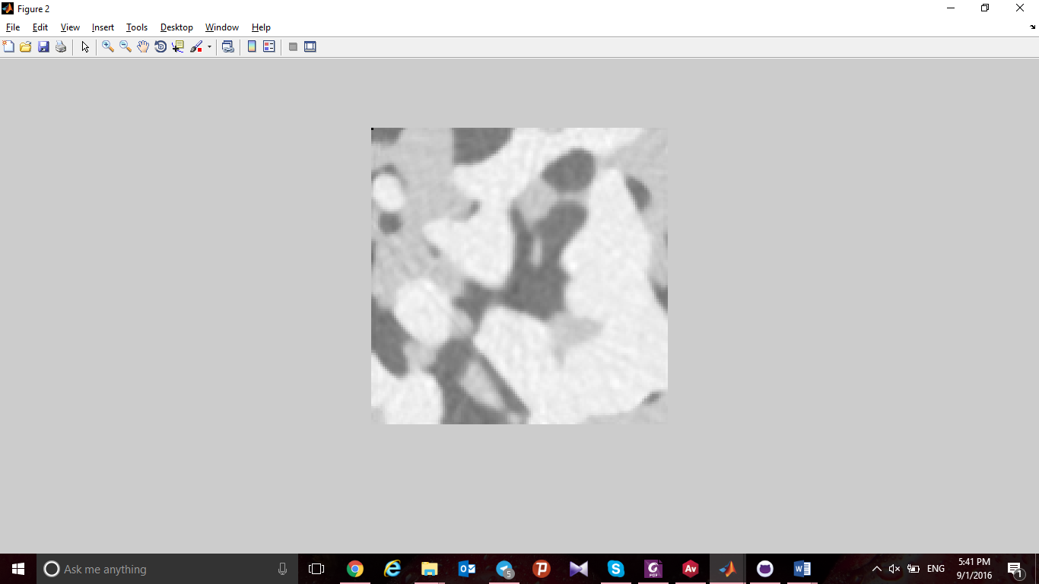
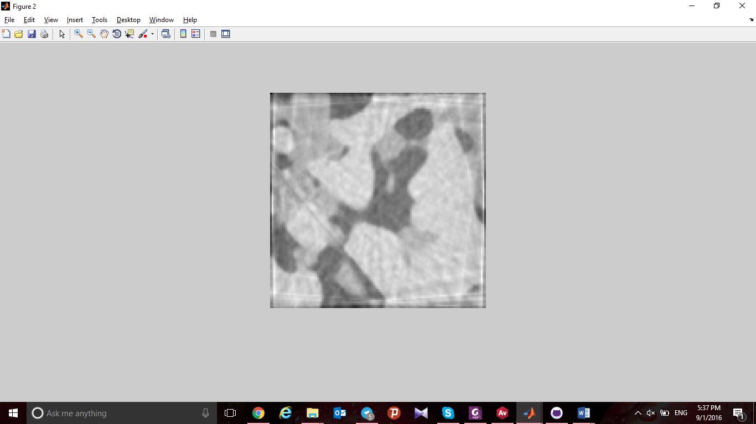
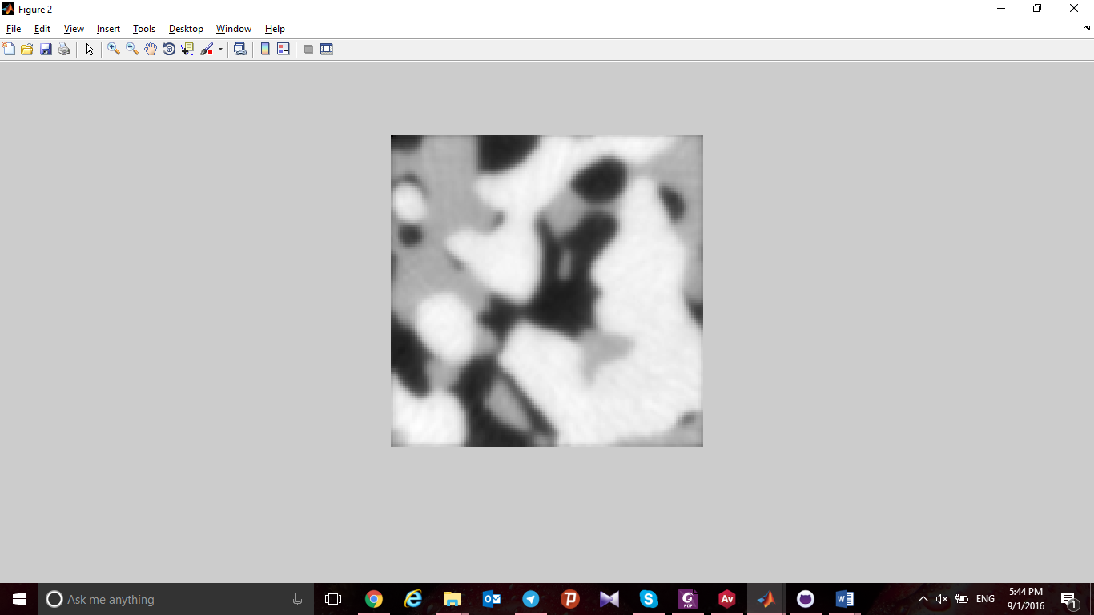
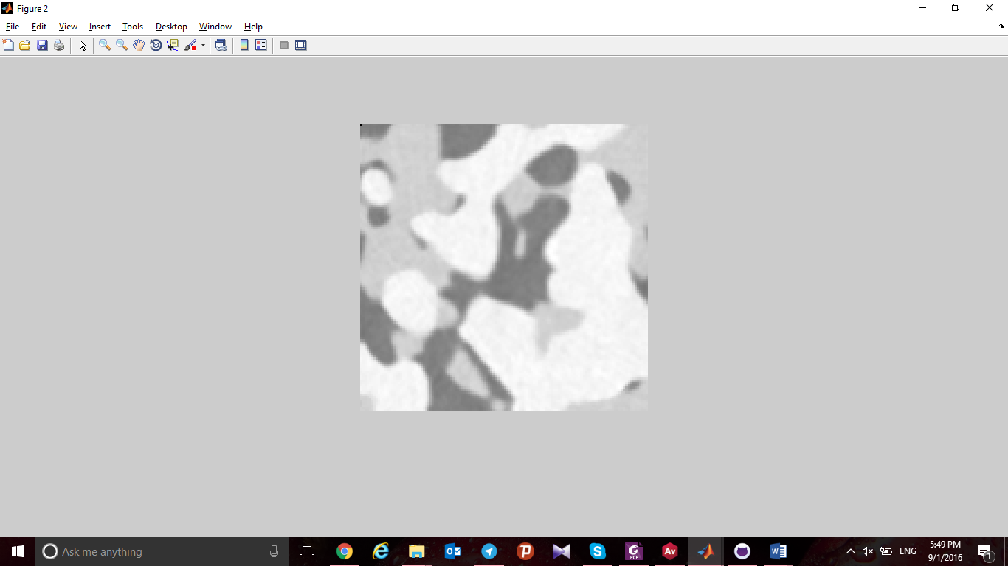
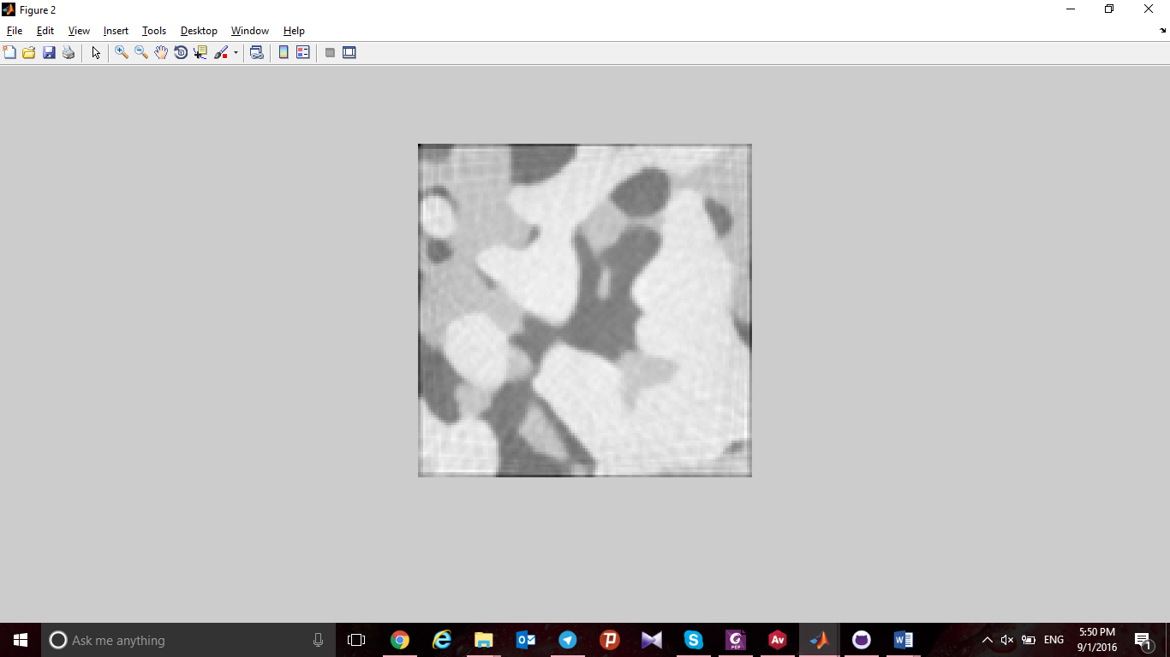
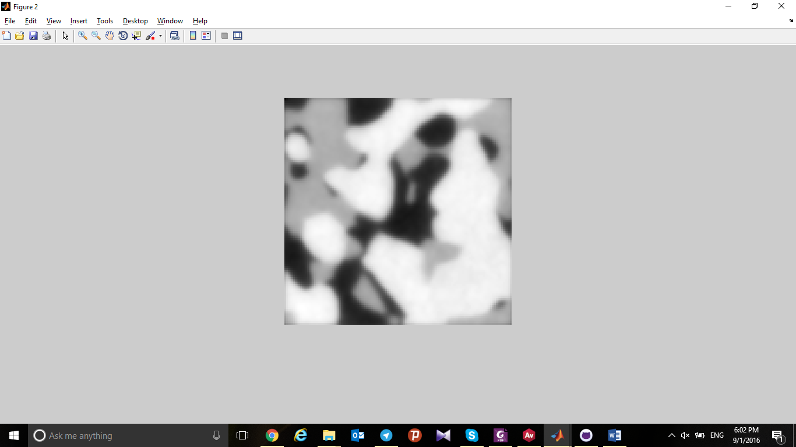
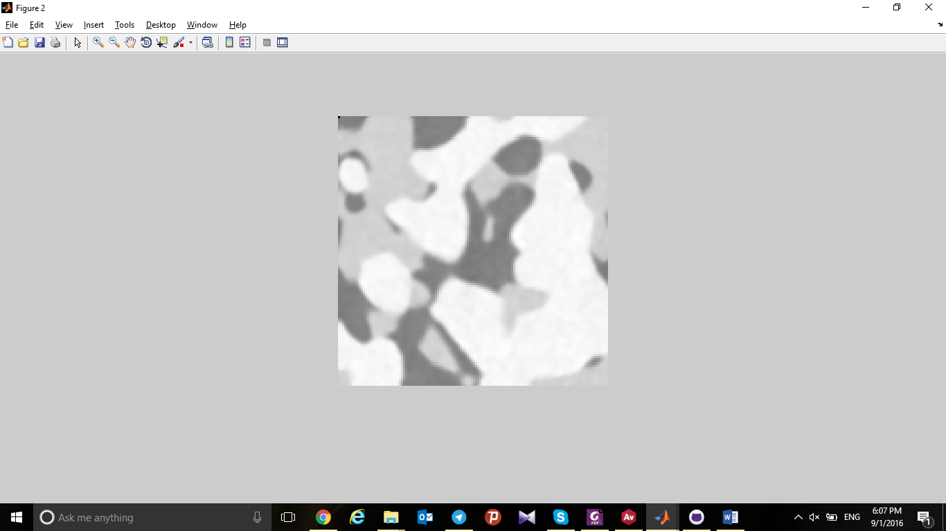
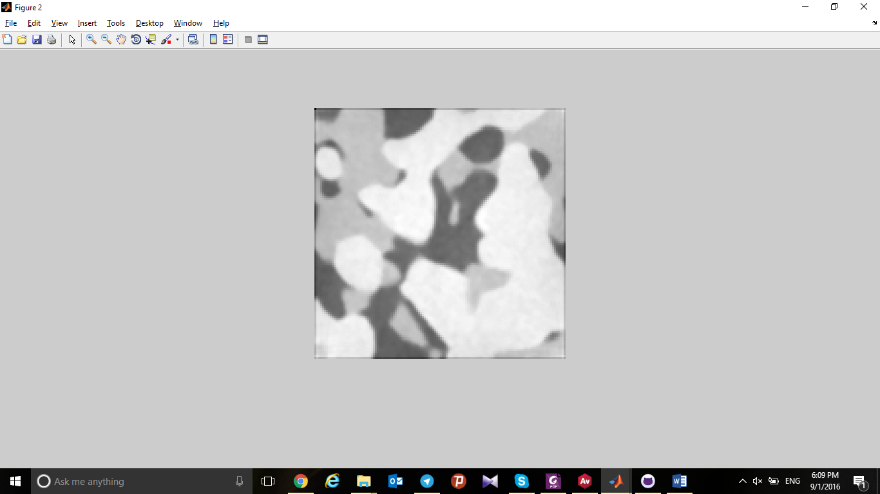
CGLS
SIRT
FDK
50 projections
8e-4
2e-4
3.5e-2
100 projections
7.2e-4
5e-5
3.4e-2
400 projections
7e-4
2e-5
3.2e-2

Slide 14
Real data example

Slide 15
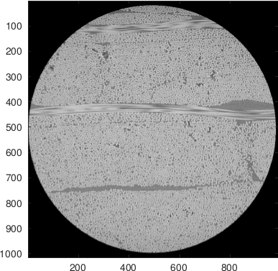
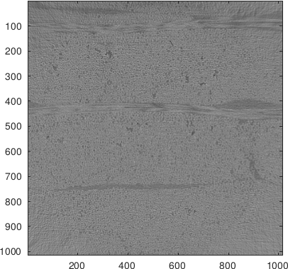
Center slice: vendor vs FDK, cone

Slide 16
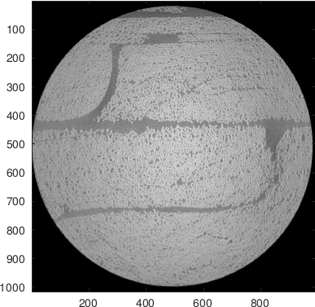
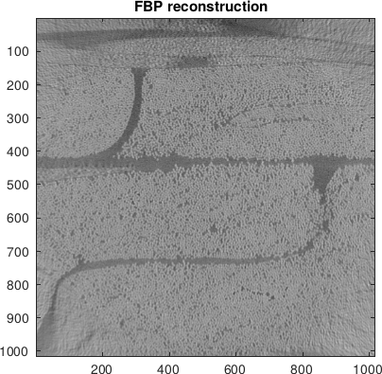
Off center, slice 10, vendor vs FBP

Slide 17
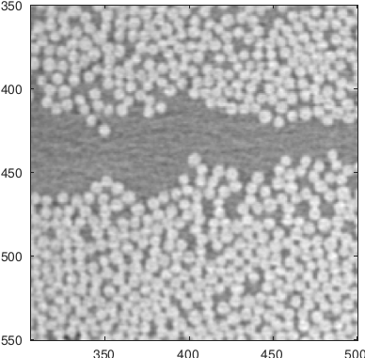
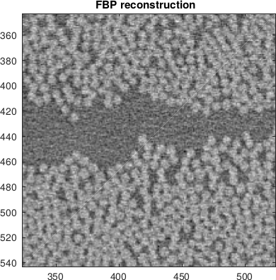
Previous slide zoomed

Slide 18
3D Reconstruction
Small MATLAB run

Slide 19
Lessons learned
3D Reconstructions from projection data
Reconstruction with wrong assumptions
Inside knowledge gives ‘better’ reconstructions
Iterative methods ‘may’ requires some tweaking

